Slide 1
STUDENT PERFORMANCE INTELLIGENCE & RISK PREDICTION SYSTEM
SUPERVISED & UNSUPERVISED LEARNING

Slide 2
PROBLEM STATEMENT
Students' academic performance depends on multiple factors, but it is difficult to manually analyze their impact. There is a need for an automated system that can predict student performance based on available data. Predicting student academic performance is important for identifying learning gaps and helping students improve. In this project, we aim to predict the Expected Final Grade of students using supervised learning techniques. Multiple models are implemented and compared to identify the most effective approach.
WHY WE CHOOSE THIS PROJECT?
So, we built a system that:
Predicts academic performance
Identifies behavioral risks
The goal is to move from result-based analysis to behavior-based intelligence.

Slide 3
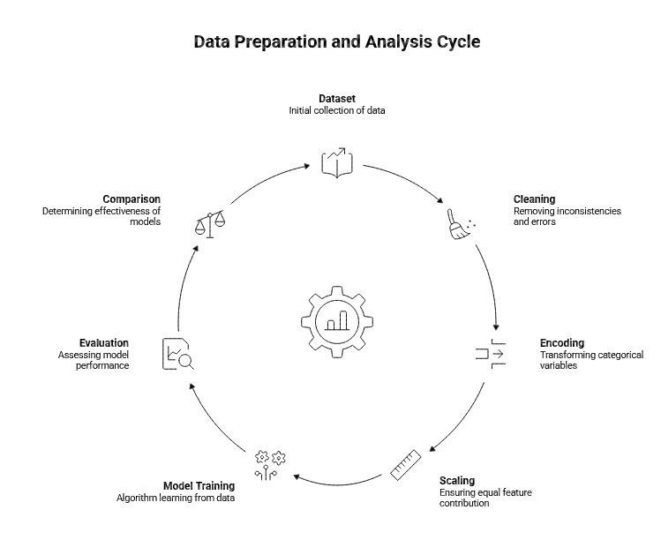
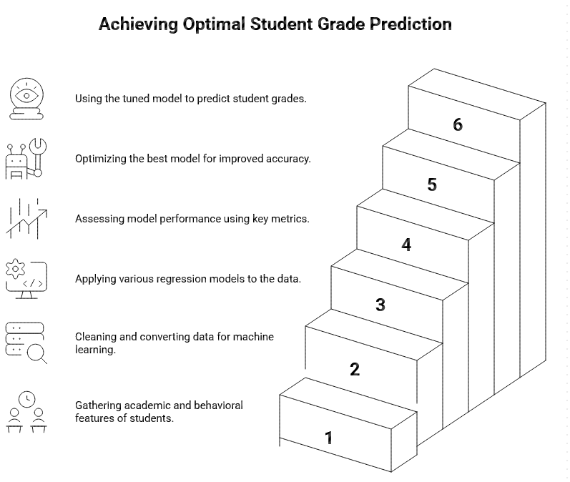

Slide 4
DATA CLEANING & PREPROCESSING
1. Handling Missing Values
Identified missing data in key features like backlogs, CGPA, attendance, etc.
Filled missing values using:
Mode → for categorical/discrete data (e.g., number of backlogs)
Mean → for numerical features (e.g., CGPA, study hours, sleep hours)
Converted all values into a uniform percentage format (0–100)
Handled invalid/missing entries using average values
5. Converting Range Values
Some inputs were given as ranges (e.g., “3–5 hours”)
Converted them into a single representative value (average of range)
Ensured all features are numeric and usable for ML models
2. Removing Irrelevant Data
Dropped unnecessary columns (e.g., Score)
Ensured dataset only contains meaningful features for prediction
6. Final Missing Value Treatment
Rechecked dataset for null values
Filled remaining missing entries using mean values
Ensured a complete and clean dataset
3. Standardizing Column Names
Cleaned column names by removing extra spaces
Ensured consistency for easier processing and model training
7. Data Ready for Modeling
All features converted into numerical format
No missing or inconsistent data
Dataset is now structured and ready for machine learning algorithms
4. Cleaning Attendance Data
Extracted numeric values from inconsistent formats (e.g., “80%”, “0.8”)

Slide 5
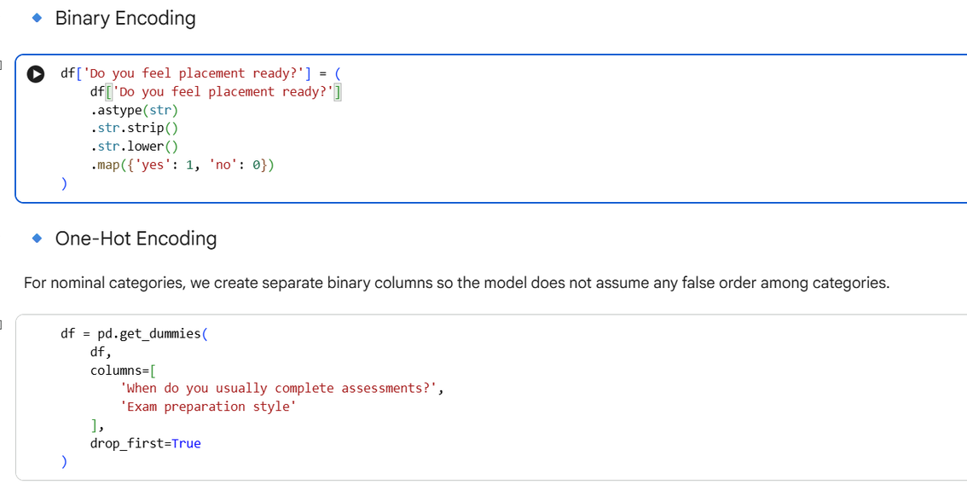
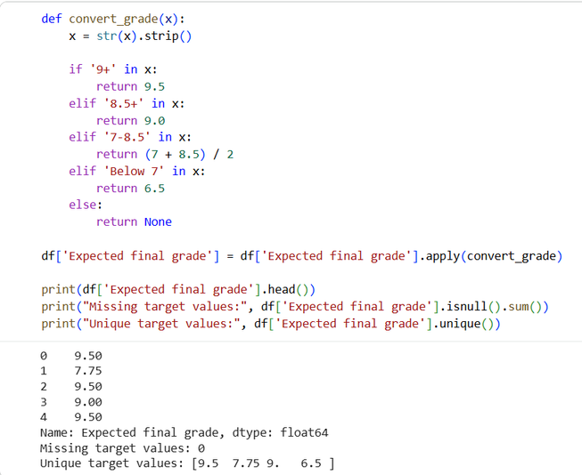
FEATURE ENGINEERING
We choose Expected final grade as the target variable because it is the outcome we want to predict using student academic and behavioral features.
The target column contains grade ranges in text form.
We convert these into numeric values so the model can learn from them.
Machine learning models work with numbers, so text-based categories must be converted into numeric form.

Slide 6
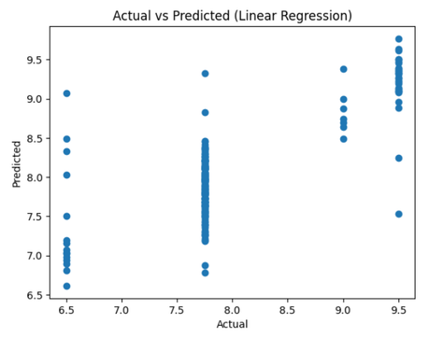
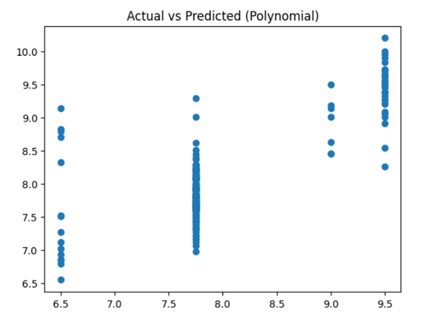
MODELS
LINEAR REGRESSION
POLYNOMIAL REGRESSION
Linear Regression is one of the most fundamental supervised learning algorithms used for predicting continuous numerical values. Since our target variable, "Expected final grade," is numerical after preprocessing, Linear Regression is an appropriate starting model.
Polynomial Regression helps capture these non-linear relationships by adding higher-degree terms (like squared or cubic features).
Why use Polynomial Regression?
- It can model more complex feature-target relationships
- It may improve prediction performance over simple Linear Regression
- It helps test whether the data has useful non-linear structure

Slide 7
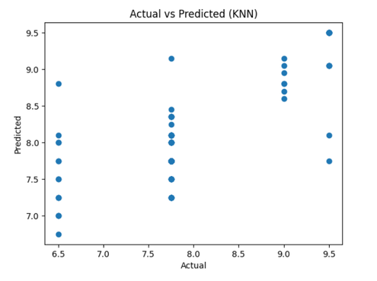
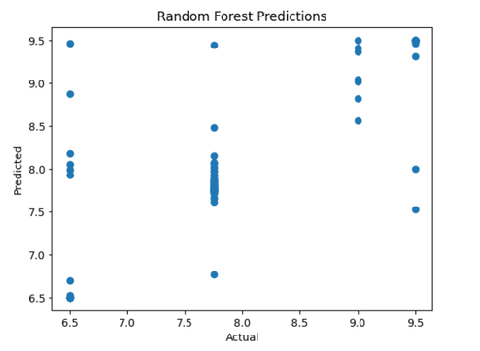
MODELS
KNN REGRESSION
RANDOM FOREST REGRESSION
KNN (K-Nearest Neighbors) is a distance-based algorithm. It predicts the value of a data point by averaging the values of its nearest neighbors.
We use KNN because:
It works well when relationships are non-linear
It is simple and does not require training a model explicitly
It helps compare performance with a completely different approach
Random Forest is an improved version of Decision Tree. Instead of using one tree, it builds multiple trees and combines their predictions.
This reduces overfitting and improves accuracy.
Why we are using Random Forest
Reduces overfitting of Decision Trees
More stable and accurate
Works well for complex and non-linear data
Uses ensemble learning (multiple models combined)

Slide 8
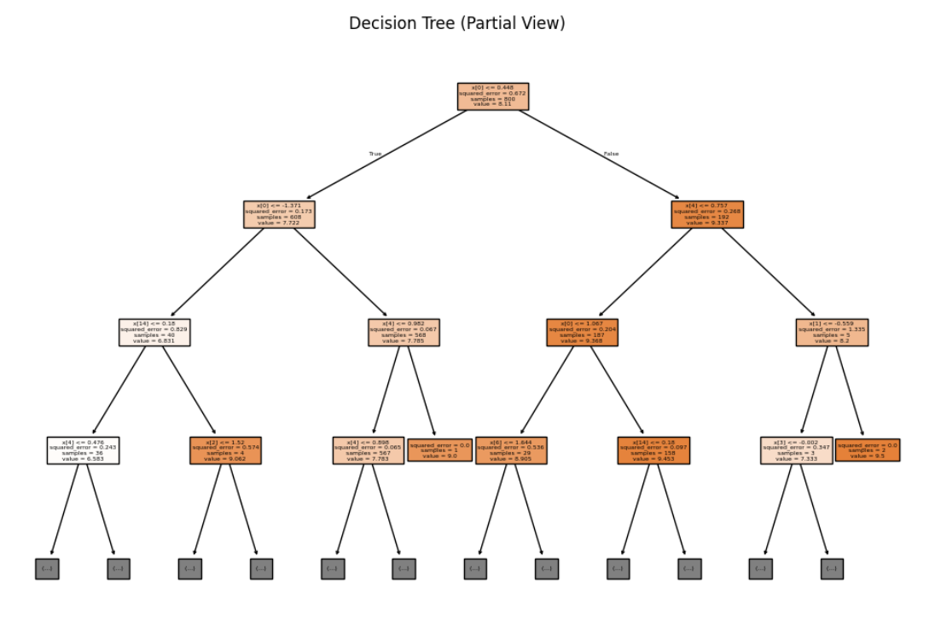
MODELS
DECISION TREE REGRESSION
Decision Tree is a rule-based model that splits data into branches based on feature values. It does not assume linear relationships and can capture complex patterns.
Why we are using Decision Tree
Works well for non-linear data
Easy to interpret (decision rules)
No need for feature scaling
Helps compare with KNN and Linear models
Important Concept
Decision Trees can easily overfit if not controlled, because they try to perfectly fit training data.

Slide 9
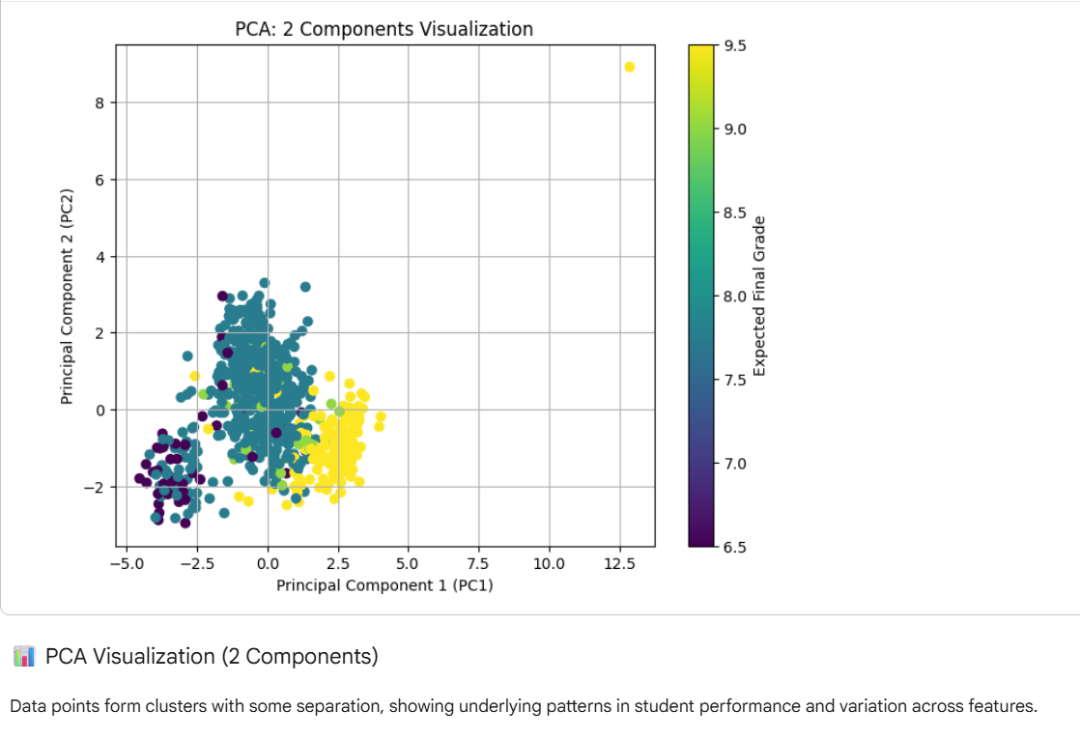
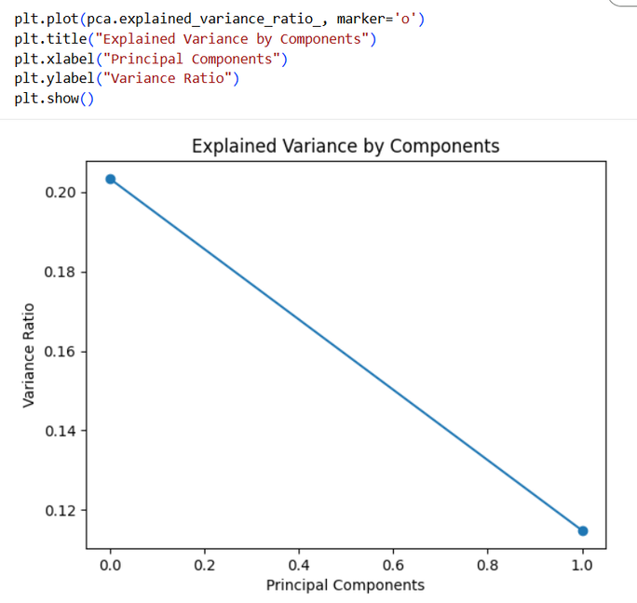
PCA (PRINCIPAL COMPONENT ANALYSIS)
PCA reduces high-dimensional data into a smaller number of components while preserving as much variance as possible.
Here, PCA is mainly used for:
- visualizing the dataset in 2 dimensions
- understanding structure in compressed form

Slide 10
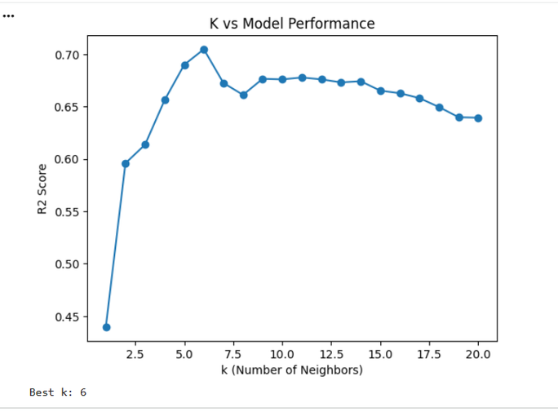
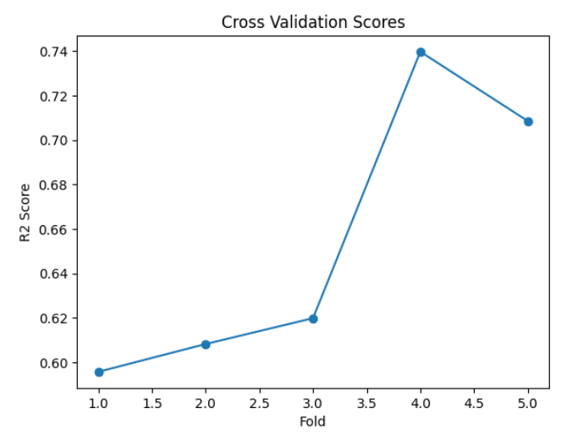
HYPERPARAMETER TUNING IN KNN
Hyperparameter tuning is the process of choosing the best values of model settings (like k in KNN) to get the most accurate predictions.
We use hyperparameter tuning because:
It helps improve the model’s accuracy and performance
It finds the best combination of parameters instead of using random values
It makes the model more reliable and efficient
CROSS VALIDATION
It gives a more reliable estimate by repeatedly training and validating the model on different folds of the training data.
Why use Cross Validation?
- Reduces dependence on one random split
- Gives a more stable estimate of model performance
- Helps check whether the model generalizes consistently

Slide 11
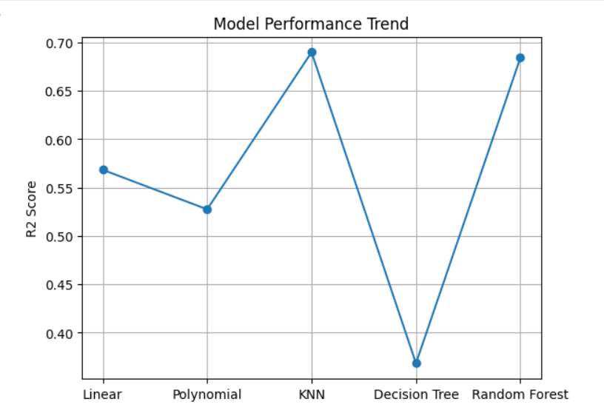
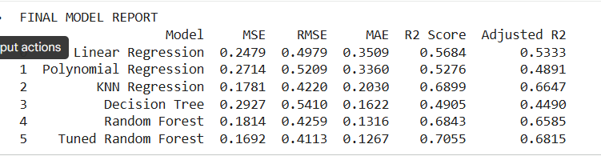
FINAL MODEL
Although KNN may achieve the highest R² in a single split, RANDOM FOREST is selected as the final model because it is more stable, less sensitive to noise, and generalizes better.

Slide 12
THANK YOU

